Slide 1
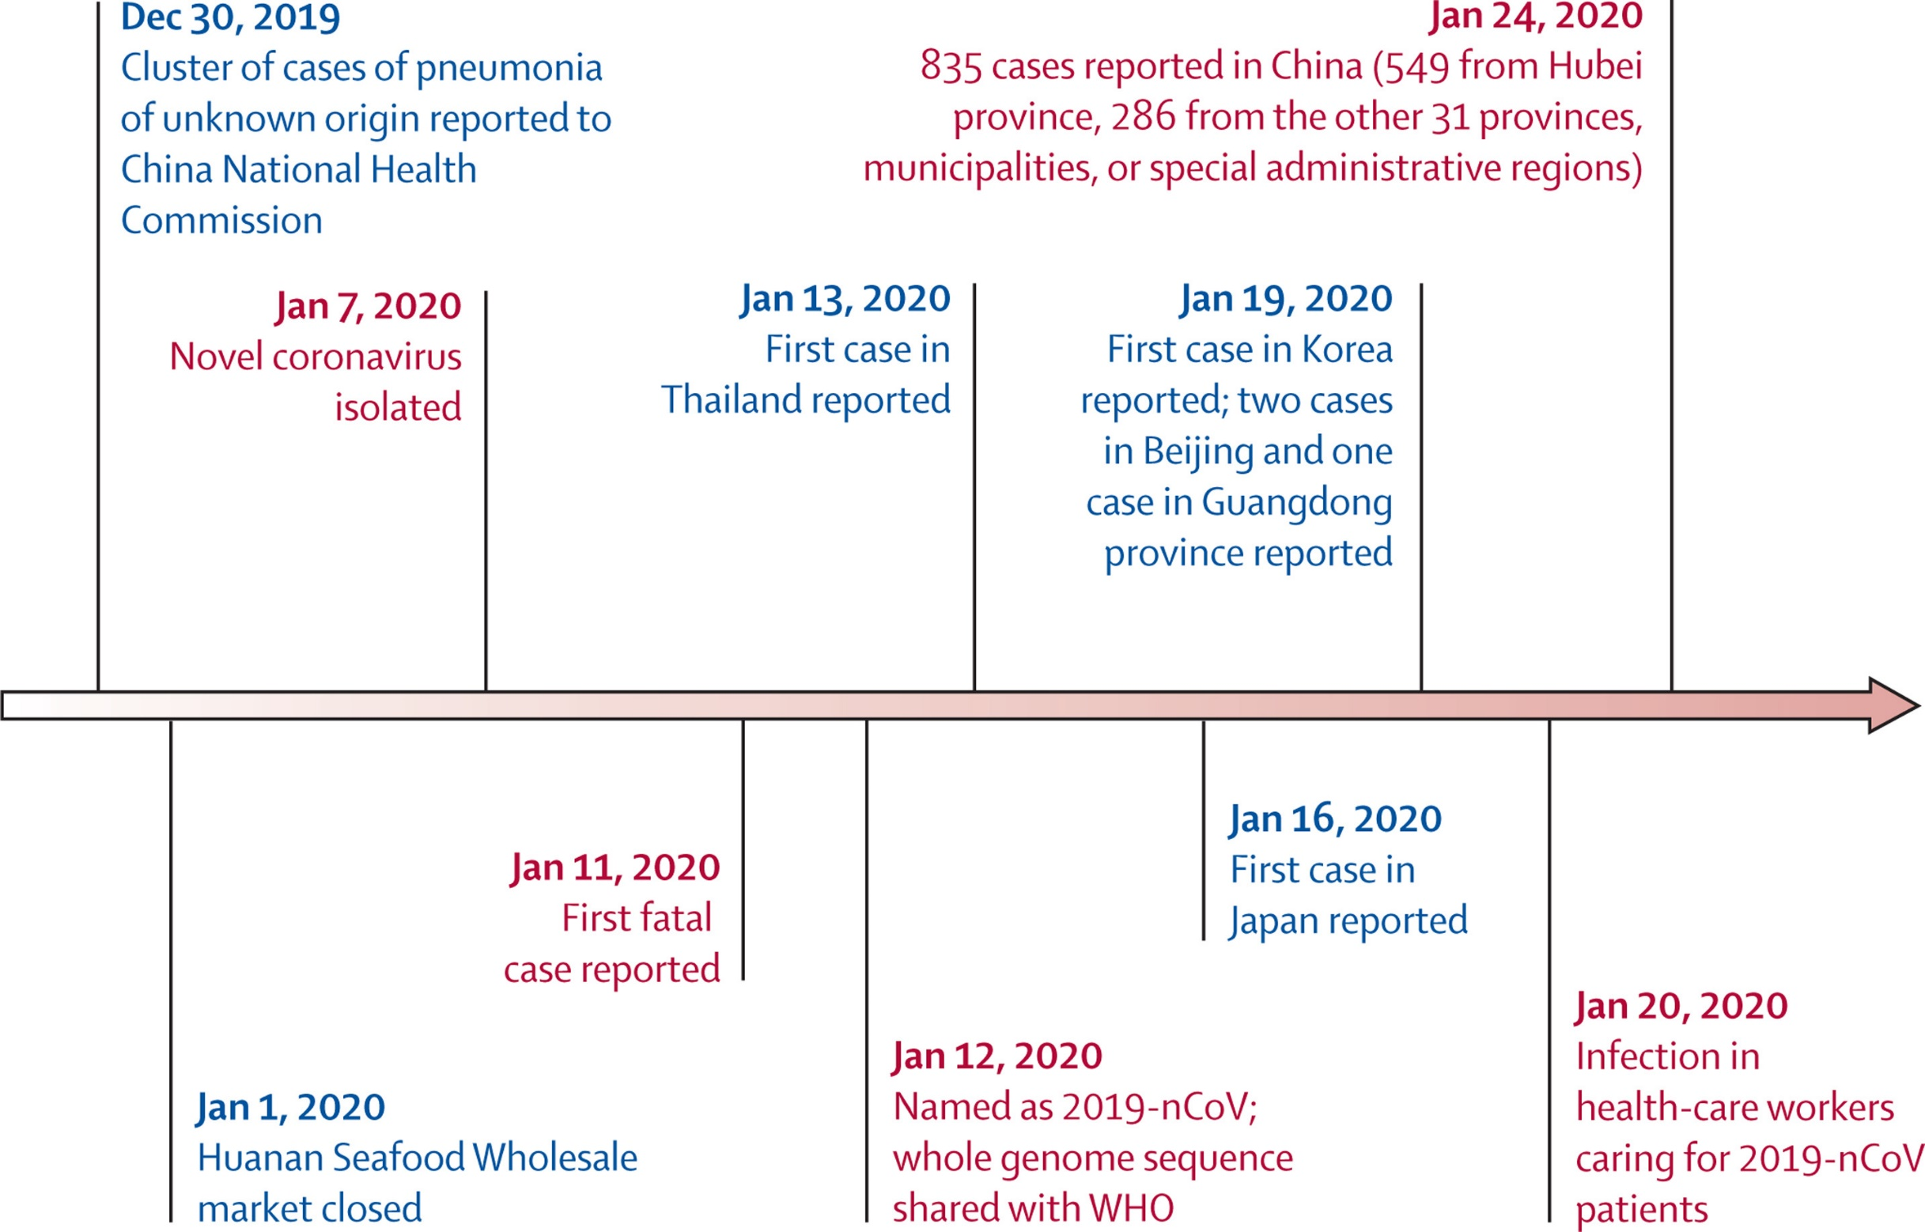
Timeline of early stages of 2019-nCoV outbreak (Wang et al. 2019)

Slide 2
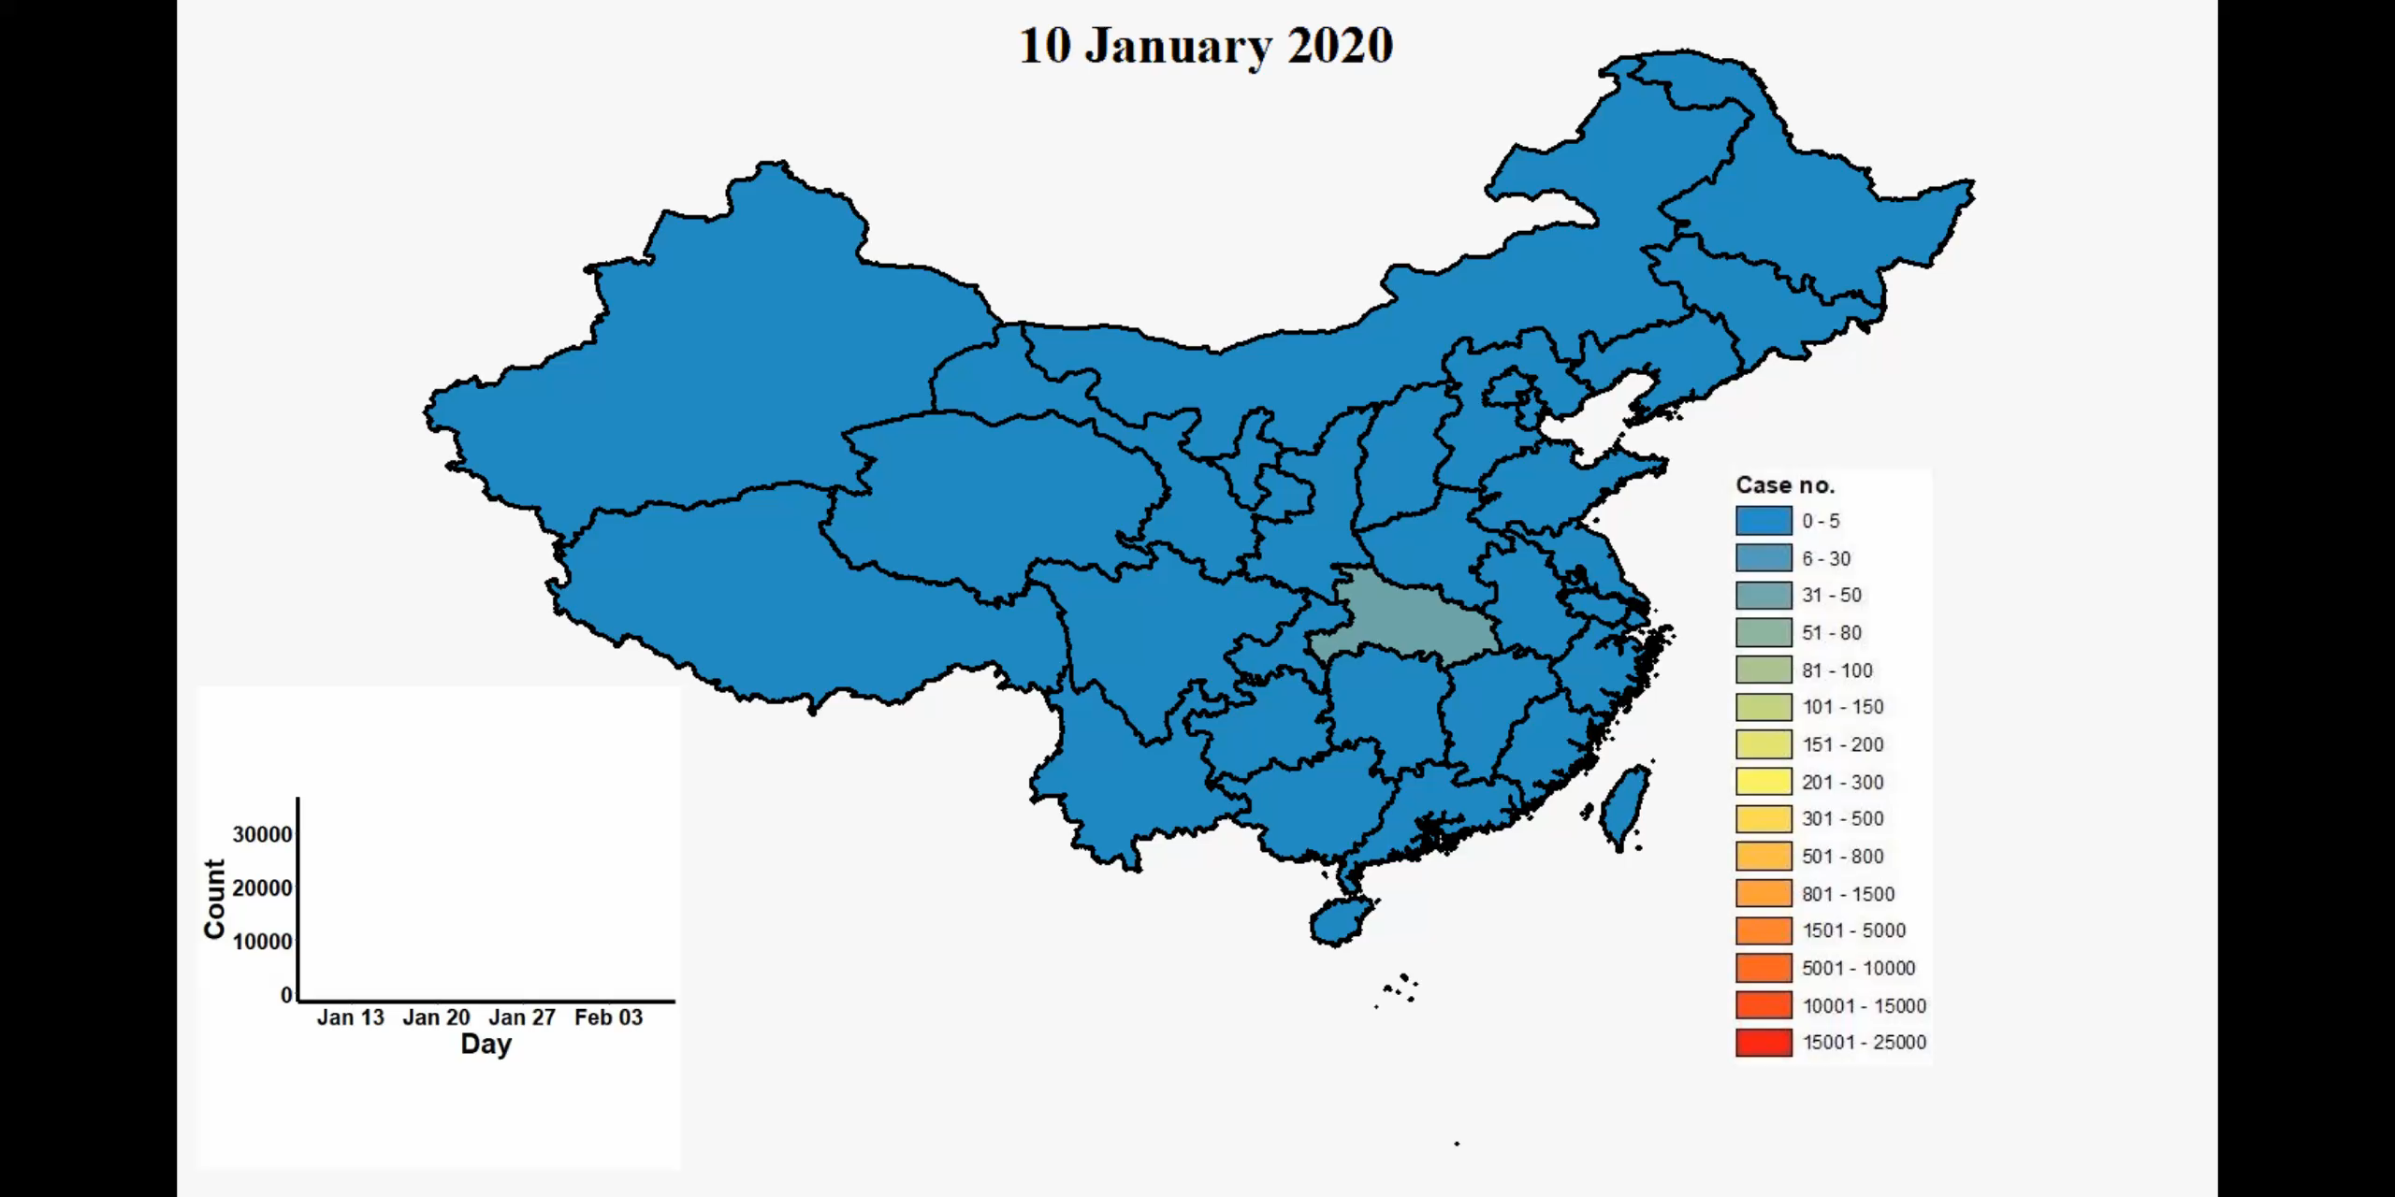

Slide 3
National (data from NHC of China)
New cases
Confirmed (cumulative ):44653
Confirmed (current): 38800 (86.9%)
severe: 8204 (21.1%)
Deaths: 1113 (2.5%)
Recovered: 4740 (10.6%)
Fatality/recovery rate
Close contacts: 451462
Quarantined: 185037

Slide 4
Hubei (data from NHC of China)
Newly confirmed cases
Deaths/Recovered
Fatality rate
Recovery rate

Slide 5
Outside of China (mixed data sources)
Cumulative confirmed cases
Newly confirmed cases
24 countries; 400 confirmed, 136 are from the cruise ship in Japan.
First case outside of China reported in Thailand on 13 Jan.
First (only) fatal case outside of China occurred in Philippines on 2 Feb.
Transmission occurred in 12 countries (WHO).
No new countries reported cases of 2019-nCoV in the past one week (WHO).

Slide 6
Chain of infection
Source of infection | Cases infected with 2019-nCoV. Asymptomatic cases can also be the source.
Transmission routes | Respiratory droplets and contact are the main routes. Transmission through aerosols and digestive tract and vertical transmission remains to be confirmed.
Susceptible population | People of all age groups are susceptible, especially the elderly people and those with underlying conditions. Cases of children and infants have also reported.
Incubation period | 3 to 7 days. Contagious during incubation period, but asymptomatic cases are less contagious.
Hosts | Wild animals, possibly Chinese horseshoe bats. Pangolin (Intermediary host)?

Slide 7
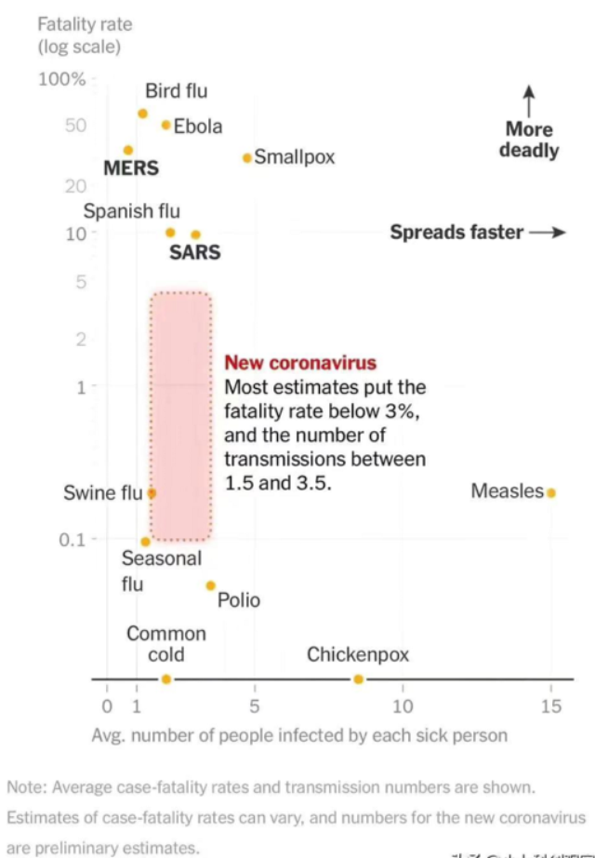
Comparison between COVID-2019 and SARS
On 8 Feb. Leishenshan Hospital began its operation.
On 31 Jan. WHO declares coronavirus an international emergency
On 3 Feb. Huoshenshan Hospital began its operation.

Slide 8
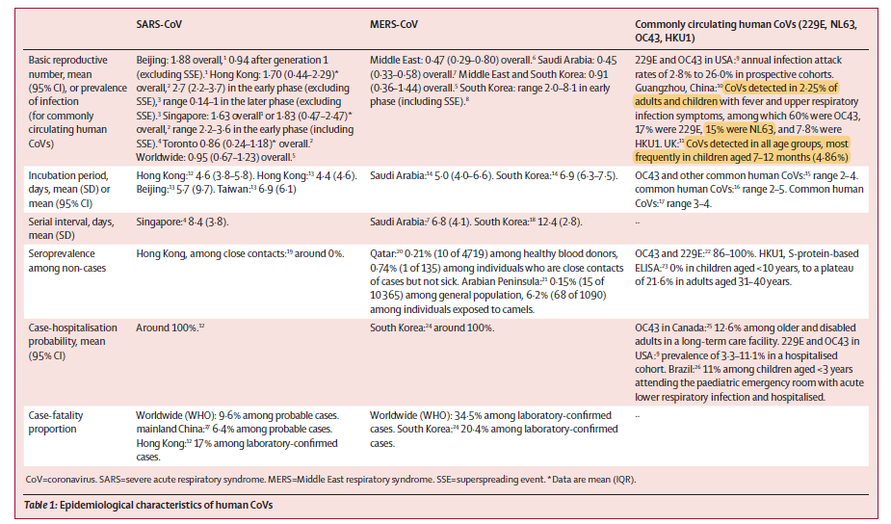
Joseph et al, 2020

